Slide 1
Adding and Subtracting Decimals
Sec 1.2

Slide 2
Objective
The students will be able to add and subtract decimals and use properties of addition to do mental math.

Slide 3
Adding Decimals
3.62 + 2.5
3.62 Align the decimal point
+2.50 Add a zero so both addends have same number of decimal places
6.12 Add the columns

Slide 4
Examples
3.52 + 4.5 3.12 + 4.6

Slide 5
Subtracting Decimals
89.9 – 46.78
89.90 Align decimal points and add a zero
-46.78
8 10
89.90 Regroup
-46.78
43.12 Subtract

Slide 6
Examples
26.7 – 14.81 98.8 – 59.9

Slide 7
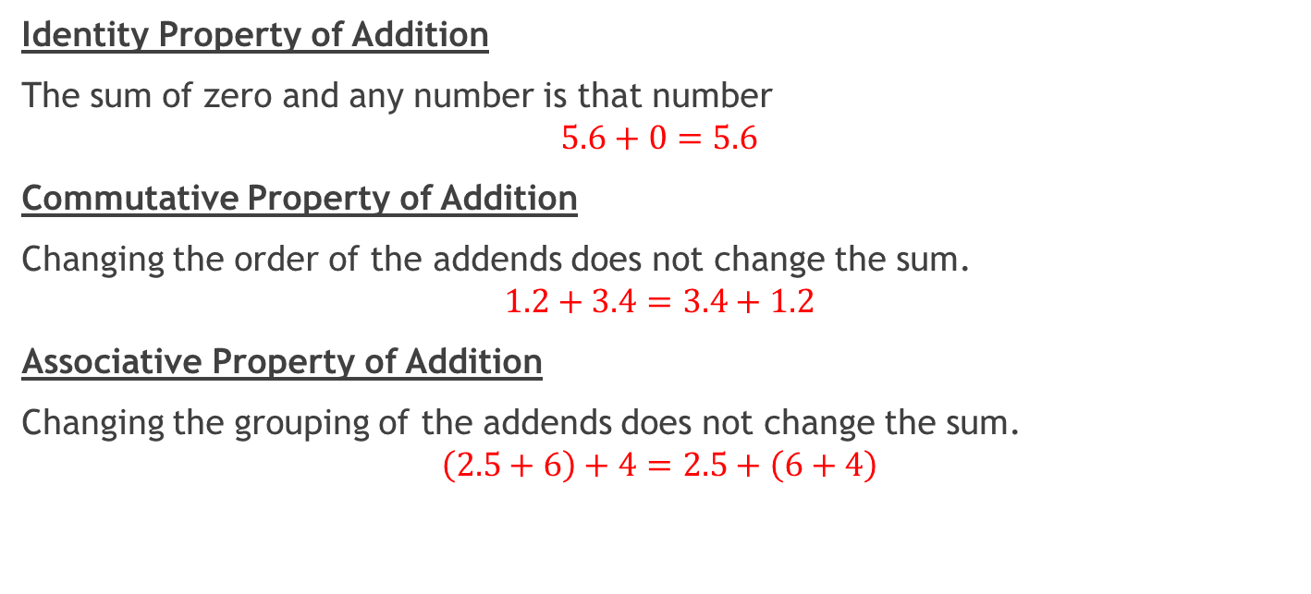
Properties of Addition
Identity Property of Addition
The sum of zero and any number is that number
$$5.6+0=5.6$$
Commutative Property of Addition
Changing the order of the addends does not change the sum.
$$1.2+3.4=3.4+1.2$$
Associative Property of Addition
Changing the grouping of the addends does not change the sum.
$$\left(2.5+6\right)+4=2.5+\left(6+4\right)$$

Slide 8
Using the properties of addition
Find 0.7 + 12.5 + 1.3
Look for compatible numbers. 1.3 and 0.7 is 2 then add 2 to 12.5 to get 14.5
Why does it work?

Slide 9
Example
Find 4.4 + 5.3 + 0.6 using mental math.

Slide 10
Questions?

Slide 11
Exit ticket
45.6 – 23.72 12.45 + 43.9
Find 6.7 + 3.3 + 10.8 using mental math

Slide 12
Worksheet

