Slide 1
Area of a parallelogram
Chapter 8
Section 8.2

Slide 2
Objective
The students will be able to find the area of a parallelogram.

Slide 3
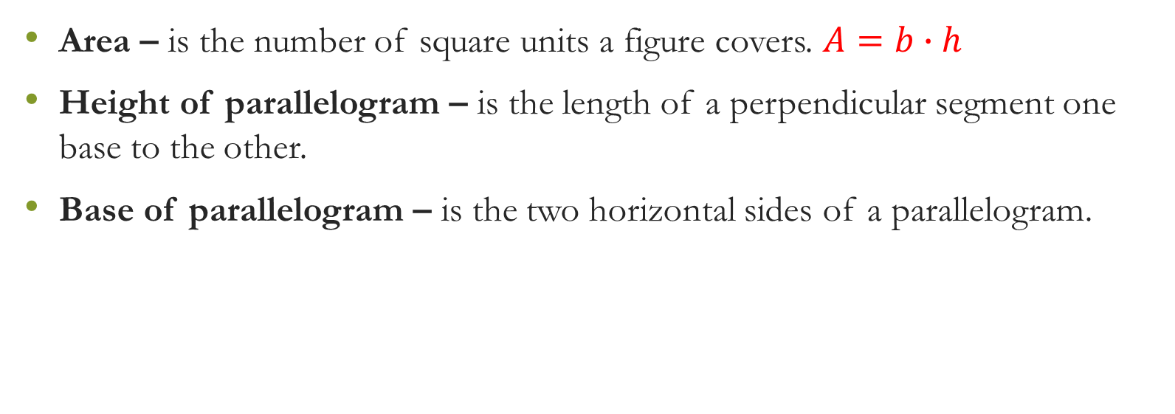
Vocabulary
Area – is the number of square units a figure covers. $A=b∙h$
Height of parallelogram – is the length of a perpendicular segment one base to the other.
Base of parallelogram – is the two horizontal sides of a parallelogram.

Slide 4
Concept
Base Base
Height Height
Base Base

Slide 5
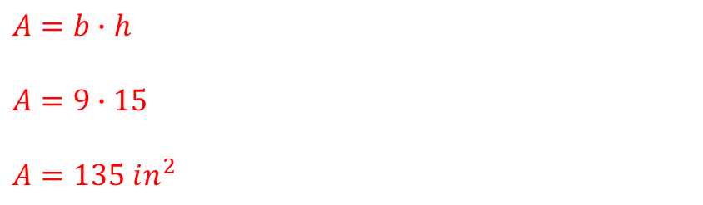
Example
$A=b∙h$
$A=9∙15$
$A=135 in^{2}$
Height=15in
Base=9in

Slide 6
Exit Ticket
9 cm
10 cm

Slide 8
Questions?

Slide 9
Worksheet

