Slide 1
Finding Percent of Change
Chapter 6
Section 6.8

Slide 2
Objective
The students will find percents of increase and decrease.

Slide 3
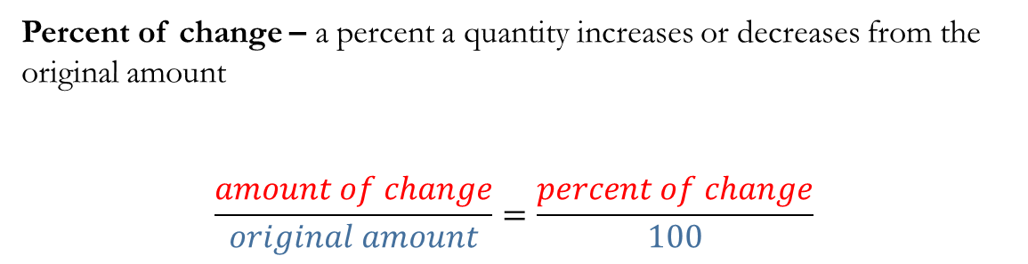
Key Concept
Percent of change – a percent a quantity increases or decreases from the original amount
$$\frac{amount of change}{original amount}=\frac{percent of change}{100}$$

Slide 4
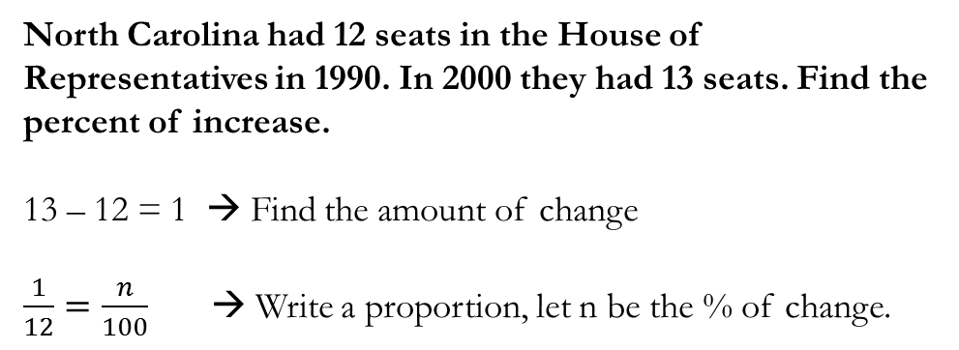
Finding a percent of change.
North Carolina had 12 seats in the House of Representatives in 1990. In 2000 they had 13 seats. Find the percent of increase.
13 – 12 = 1 → Find the amount of change
$\frac{1}{12}=\frac{n}{100}$ → Write a proportion, let n be the % of change.

Slide 5
Example
In 2000 California went from 52 to 53 representatives. Find the percent of change.

Slide 6
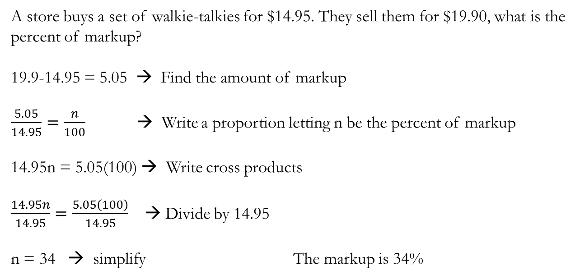
Finding the Percent of Markup
A store buys a set of walkie-talkies for $14.95. They sell them for $19.90, what is the percent of markup?
19.9-14.95 = 5.05 → Find the amount of markup
$\frac{5.05}{14.95}=\frac{n}{100}$ → Write a proportion letting n be the percent of markup
14.95n = 5.05(100) → Write cross products
$\frac{14.95n}{14.95}=\frac{5.05\left(100\right)}{14.95}$ → Divide by 14.95
n = 34 → simplify The markup is 34%

Slide 7
Example
Find the markup for a $17.95 headset marked up to $35.79.

Slide 8
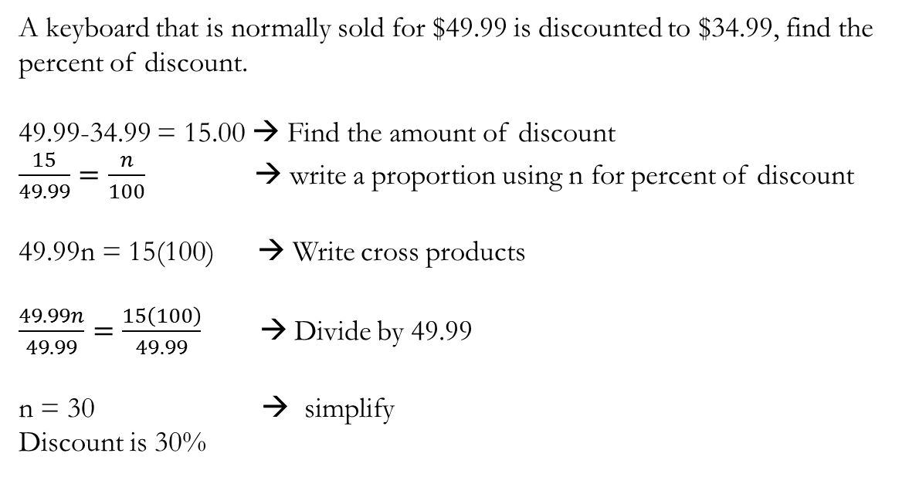
Finding the percent of discount
A keyboard that is normally sold for $49.99 is discounted to $34.99, find the percent of discount.
49.99-34.99 = 15.00 → Find the amount of discount
$\frac{15}{49.99}=\frac{n}{100}$ → write a proportion using n for percent of discount
49.99n = 15(100) → Write cross products
$\frac{49.99n}{49.99}=\frac{15\left(100\right)}{49.99}$ → Divide by 49.99
n = 30 → simplify
Discount is 30%

Slide 9
Example
Find the percent of discount of a book that normally sells for $24.95 but is on sale for $14.97.

Slide 10
Questions?

Slide 11
Exit Ticket
Find the percent of change for 40 to 60.
Find the percent of markup for an item costing $36 marked up to $45
Find the discount of an item that costs $60 discounted to $45

Slide 12
Worksheet

