Slide 1
Exponents and Order of Operations
Sec 2.1

Slide 2
Objective
The students will learn to write and simplify exponents.

Slide 3
Googal
A googol is a number written as 1 followed by 100 zeros.

Slide 4
Vocabulary
Exponent – tells you how many times a number is used as a factor
Base – this is the number used as a factor
Power – this is a number that can be written as an exponent
125 is a power of 5 because it can be written as $5^{3}$

Slide 5
Writing Expressions Using Exponents
Write $3∙3∙3∙3∙3$ using exponents.
$3∙3∙3∙3∙3$ = $3^{5}$
Write $(−2)∙(−2)$ using exponents.
$(−2)∙(−2)$ = ${(−2)}^{2}$

Slide 6
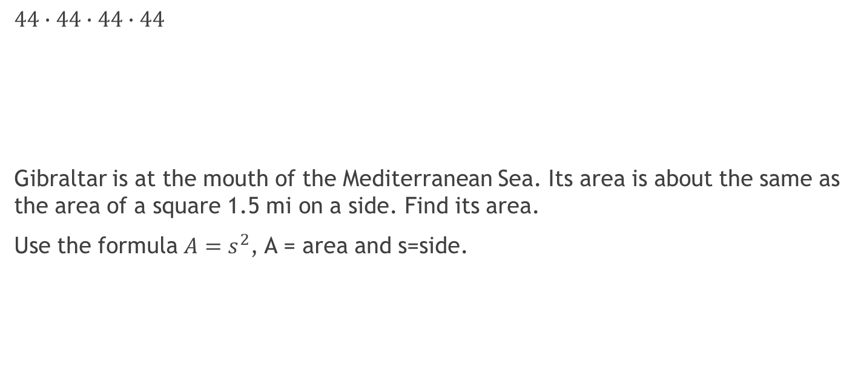
Examples
$44∙44∙44∙44$
Gibraltar is at the mouth of the Mediterranean Sea. Its area is about the same as the area of a square 1.5 mi on a side. Find its area.
Use the formula $A=s^{2}$, A = area and s=side.

Slide 7
Questions?

Slide 8

Exit ticket
$7∙7∙7∙7∙7∙7$ (-5)(-5)

Slide 9
Assignment
Pg. 70-71 9-36 all

