Slide 1
Experimental Probability
Chapter 12
Section 12.2

Slide 2
Objective
The students will be able to find experimental probability and to use simulations.

Slide 3
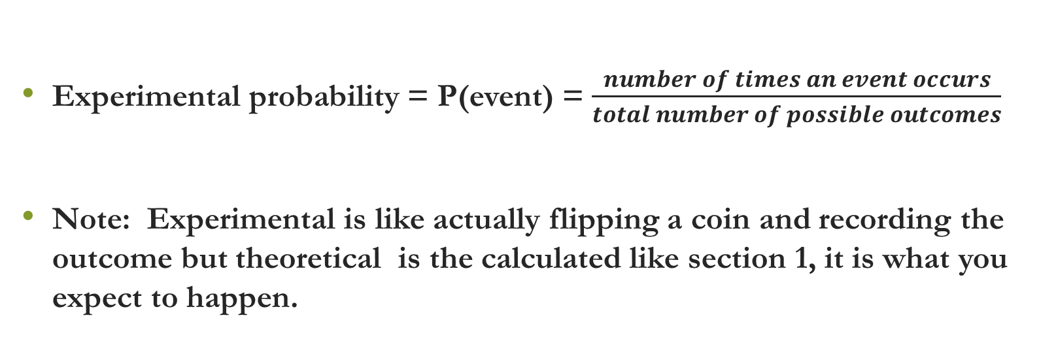
Vocabulary
Experimental probability = P(event) = $\frac{number of times an event occurs}{total number of possible outcomes}$
Note: Experimental is like actually flipping a coin and recording the outcome but theoretical is the calculated like section 1, it is what you expect to happen.

Slide 4
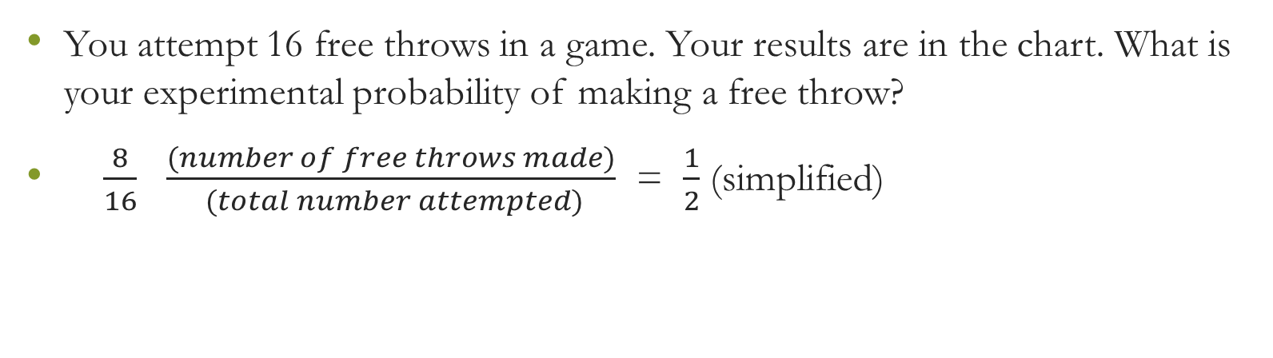
Example – Finding Experimental Probability
0=miss |  |  |  | 1=make
0 | 0 | 1 | 1 | 1 | 0 | 1 | 0
0 | 1 | 0 | 1 | 1 | 0 | 0 | 1
You attempt 16 free throws in a game. Your results are in the chart. What is your experimental probability of making a free throw?
$\frac{8}{16}$ $\frac{(number of free throws made)}{ (total number attempted)}$ = $\frac{1}{2}$ (simplified)

Slide 5
Example – Simulating an Event
Heads = Girl |  |  | Tails = Boy
TTH | TTT | HTH | HTT | HTH
TTH | HHT | HTT | THT | HHH
HHT | TTH | THH | HTH | THT
THT | THT | THT | HHH | HHH
Find the experimental probability of having 2 out 3 children in a family be girls
We simulate by tossing a coin and the results are in the table above
We find that with 20 attempts that 6 times this occurred
Therefore 3/10 or 30% of the time

Slide 6
Questions?

Slide 7
Worksheet

