Slide 1
Probability
Chapter 12
Section 12.1

Slide 2
Objective
The students will be able to find the probability and complement of an event.

Slide 3
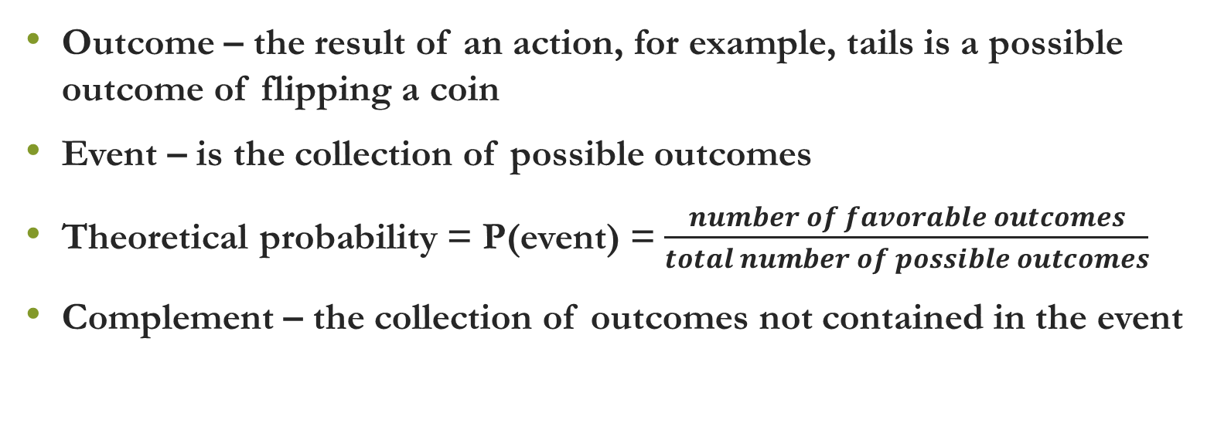
Vocabulary
Outcome – the result of an action, for example, tails is a possible outcome of flipping a coin
Event – is the collection of possible outcomes
Theoretical probability = P(event) = $\frac{number of favorable outcomes}{total number of possible outcomes}$
Complement – the collection of outcomes not contained in the event

Slide 4
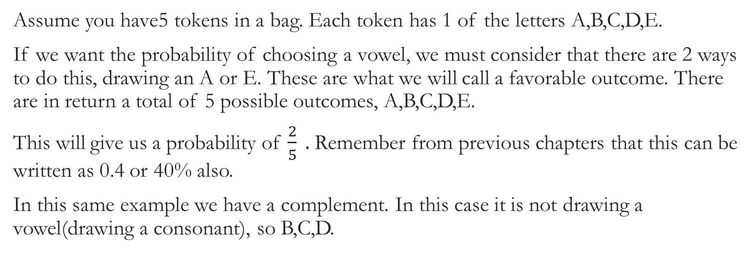
Example – Finding Probability
Assume you have5 tokens in a bag. Each token has 1 of the letters A,B,C,D,E.
If we want the probability of choosing a vowel, we must consider that there are 2 ways to do this, drawing an A or E. These are what we will call a favorable outcome. There are in return a total of 5 possible outcomes, A,B,C,D,E.
This will give us a probability of $\frac{2}{5} .$ Remember from previous chapters that this can be written as 0.4 or 40% also.
In this same example we have a complement. In this case it is not drawing a vowel(drawing a consonant), so B,C,D.

Slide 5
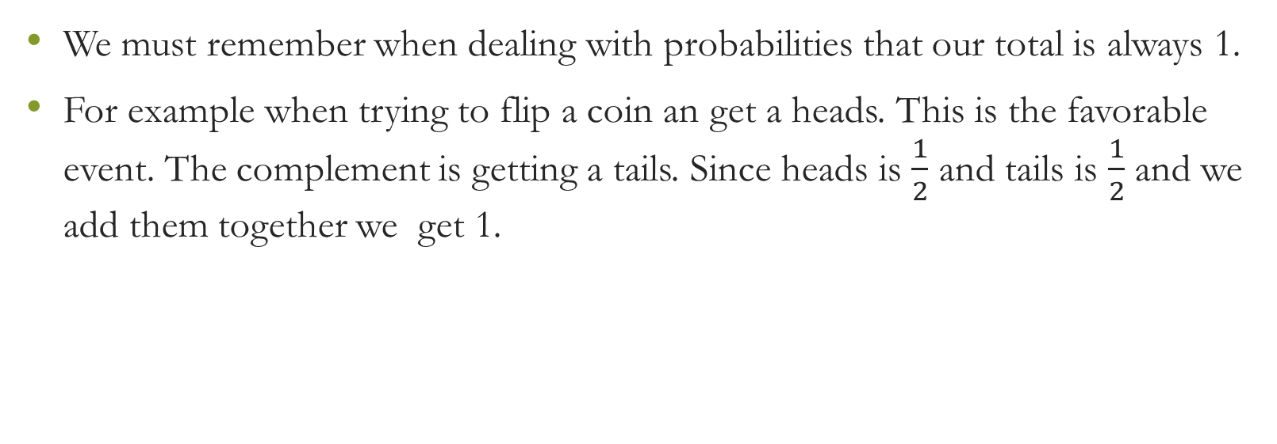
Total Outcomes
We must remember when dealing with probabilities that our total is always 1.
For example when trying to flip a coin an get a heads. This is the favorable event. The complement is getting a tails. Since heads is $\frac{1}{2}$ and tails is $\frac{1}{2}$ and we add them together we get 1.

Slide 6
Questions?

Slide 7
Worksheet

