Slide 1
Finding the Slope of a Line
Chapter 10
Section 10.3

Slide 2
Objective
The students will be able to find the slope of a line and use it to solve problems.

Slide 3
Vocabulary
Slope – a ratio or number that describes the steepness of a line(rise/run)
Rise – vertical change in a line
Run – horizontal change in a line

Slide 4
Slope

Slide 5
Finding the Slope

Slide 6
Example

Slide 7
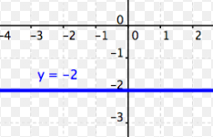
Example

Slide 8
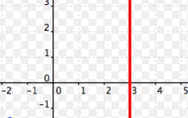
Example

Slide 9
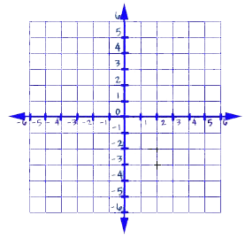
Drawing Lines on a Graph
Draw a line through the point (3,2) with slope of 2.

Slide 10
Example
Draw a line through the point (1,4) with slope of -1.

Slide 11
Example
Draw a line through the orgin with slope of -$\frac{3}{2}$.

Slide 12
Questions?

Slide 13
Worksheet

