Slide 1
Graphing Linear Equations
Chapter 10
Section 10.2

Slide 2
Objective
The students will be able to find solutions to linear equations and graph linear equations..

Slide 3
Finding Solutions
To make a tire swing, you need enough rope to reach the branch and an additional 5 feet to tie the rope.

Slide 4
Example
Find solutions to the following equations. Use x = -2, x = 0 and x = 2.
y = x + 8
y = x - 1
y = -2x

Slide 5
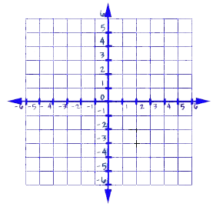
Graphing to Test Solutions
Plot the 3 ordered pairs
Draw a line through the solutions
Using the solutions for the tree swing problem, is (9,13) a possible solution to the equation?

Slide 6
Graphing Linear Equations
Linear equations may have negative values in their solutions. You can graph linear equations using positive values, negative values and zero.
Graph y = x + 1.

Slide 7
Questions?

Slide 8
Worksheet

