Slide 1
Graphing Points in Four Quadrants
Chapter 10
Section 10.1

Slide 2
Objective
The students will be able to name and graph points on a coordinate plane.

Slide 3
Vocabulary

Slide 4
Example – Graphing a point
Graph point A (3,-5)

Slide 5
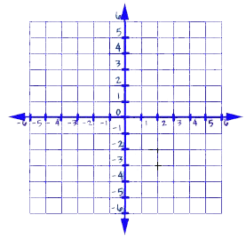
Graphing
Graph these points
(9,0) , (0,0) , (9,6) and (0,6)
Connect the points

Slide 6
Questions?

Slide 7
Worksheet

